Slide 1
Introduction to JavaScript
JavaScript is the most popular programming language today.
  Largely because of the popularity of the Web and that it is the only language available in the browsers.
JavaScript is a scripting language
  The browser receives JavaScript “code” as text and then “interprets” it into “machine code” that the computer understands.

Slide 2
JavaScript
Client
Internet
Server
Browser
URL
Web Server
HTML File
HTML File
Image File
Image File
Script
Scripts

Slide 3
JavaScript in HTML
<script>
var x=12;
var y=2;
var z=x+y;
alert(z);
</script>
Notes:
Put these lines into a file named “test.html” and open it in a browser. You can right click and “View source” to see the browser has loaded your code.

Slide 4
Math Calculations
var AngleInDegrees=12;
var DistanceInMeters=100;
var AngleInRadians=AngleInDegrees/180*Math.PI;
var X=Math.sin(AngleInRadians)*DistanceInMeters;
var Y=Math.cos(AngleInRadians)*DistanceInMeters;
alert("X="+X+", Y="+Y);
Notes:
Put these lines into a file named “test.html” and open it in a browser. You can right click and “View source” to see the browser has loaded your code.

Slide 5
Strings
You can create and manipulate “strings” of characters in JavaScript.
Each letter, number, or symbol is one character.
Strings combine characters together into phrases of text.

Slide 6
Strings in JavaScript
<script>
var String1=“hi“;
var String 2=“class”;
var String3=String1+String2;
alert(String3);
</script>
Notes:
Put these lines into a file named “test.html” and open it in a browser. You can right click and “View source” to see the browser has loaded your code.

Slide 7
Strings
Character 3
H | i |  | c | l | a | s | s
0
1
2
3
4
5
6
7
Indexes

Slide 8
Strings
Once you define a string, you can:
  Get it’s length
  “Subset” it (slice out a part of it)
  Find phrases within it
  Concatenate it with other strings

Slide 9
Types
Variables in JavaScript are defined by a “type”. There are other types but the most common are:
  Number
  String
The type determines what you can do with it:
  1+1 = 2
  “1” + “1” = “11”

Slide 10
Type Conversion
If you have a number in a string
  “123”
  “123.456”
You can convert it to a number:
  parseInt()
  parseFloat()

Slide 11
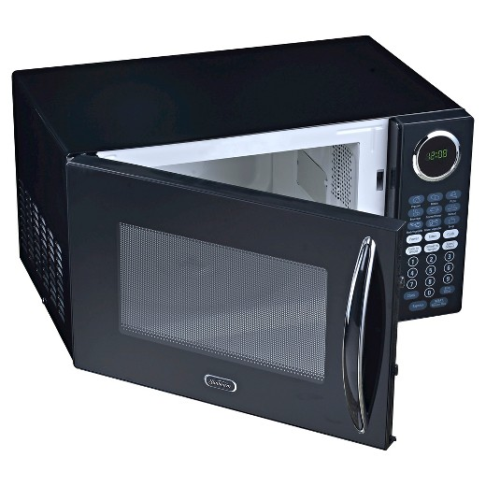
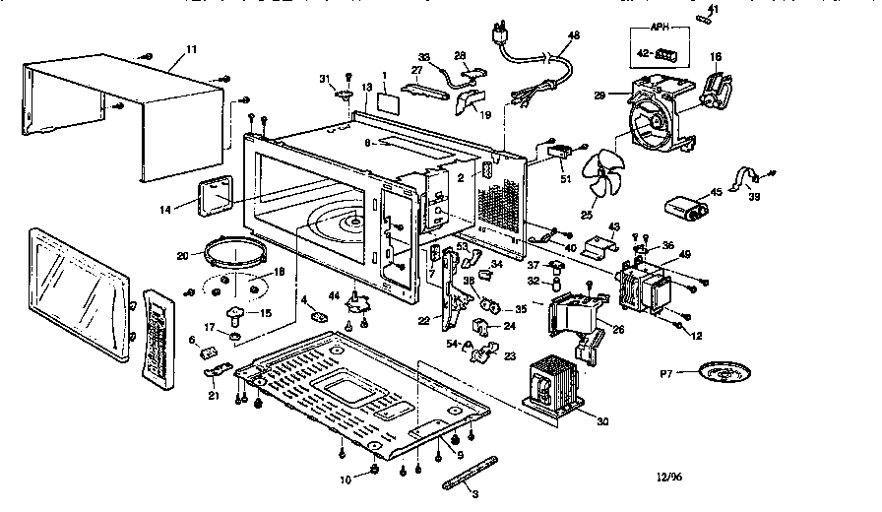
Functions
Functions “encapsulate” code so you can easily reuse the code.

Slide 12
Functions
function GetXFromAngleAndDistance(AngleInDegrees,DistanceInMeters)
{
var AngleInRadians=AngleInDegrees/180*Math.PI;
var X=Math.sin(AngleInRadians)*DistanceInMeters;
return(X);
}
function GetYFromAngleAndDistance(AngleInDegrees,DistanceInMeters)
{
var AngleInRadians=AngleInDegrees/180*Math.PI;
var Y=Math.cos(AngleInRadians)*DistanceInMeters;
return(Y);
}
var Angle=10;
var Distance=100;
var X=GetXFromAngleAndDistance(Angle,Distance);
var Y=GetYFromAngleAndDistance(Angle,Distance);

Slide 13
Basic JavaScript
For this class, all you need is:
  Calculations with numbers
  Text manipulation
  Converting text to numbers
  Functions

Slide 14
With JavaScript you can:
Do almost everything you can in other modern programming languages:
  Create variables
  Do math, date and string functions
  Create “if” statements, “for” loops, “while” loops, and functions
  Create Object Oriented Designs

Slide 15
You can also
Access and modify the contents of your web pages
Put up error dialogs
Make it look like you’re putting up windows with controls like buttons, popup menus, lists, etc.
Display dynamic maps
Interact with the user in many other ways

Slide 16
JavaScript cannot
Access the local computers disk drive, network (other than it’s original server), printer, and other resources
Launch another program
Add viruses to your computer

Slide 17
Extra slides

Slide 18
JavaScript in HTML
<script>
var ThePrefix=“Arcata is at “;
var TheCoordinateString=“40.8665° N, 124.0828° W”
TheFinalString= ThePrefix+TheCoordinateString
</script>
Notes:
Put these lines into a file named “test.html” and open it in a browser. You can right click and “View source” to see the browser has loaded your code.

